Slide 1
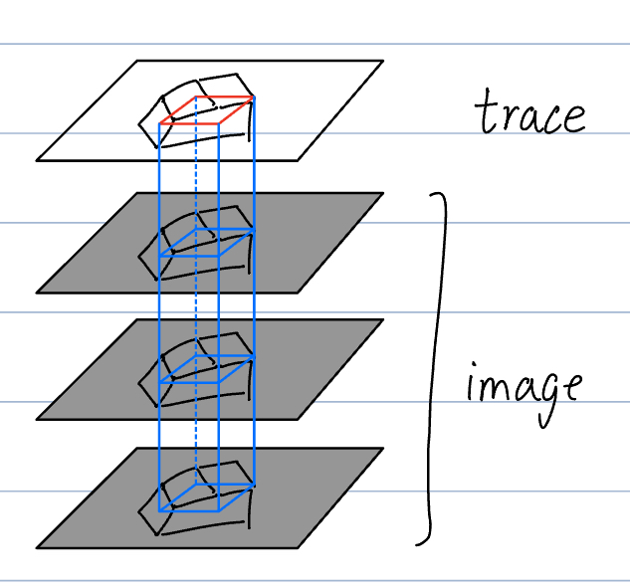
Data Augmentation
Ming Gong
March 2025

Slide 2
Loss Function Evaluation
Image
UNet model
(epochs 0-300)
Predicted image
Loss Function (BCELogit)
Tracing
(ground truth)
Pandas Dataframe
Plot
CSV

Slide 3
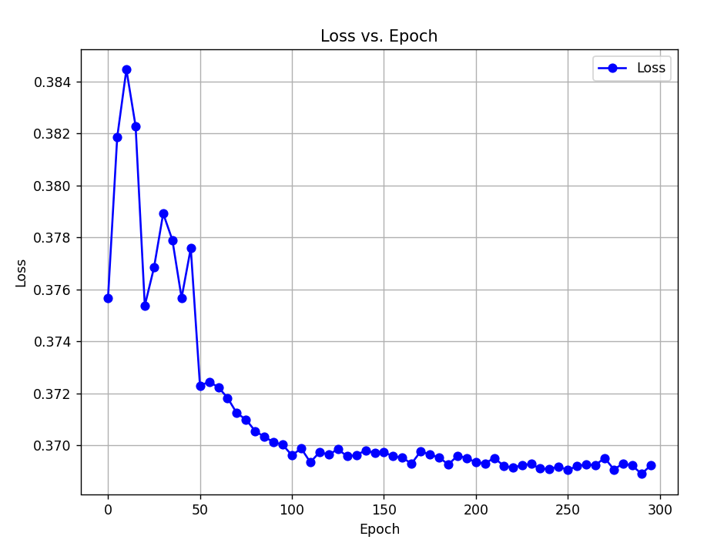
Loss vs. Epoch

Slide 4
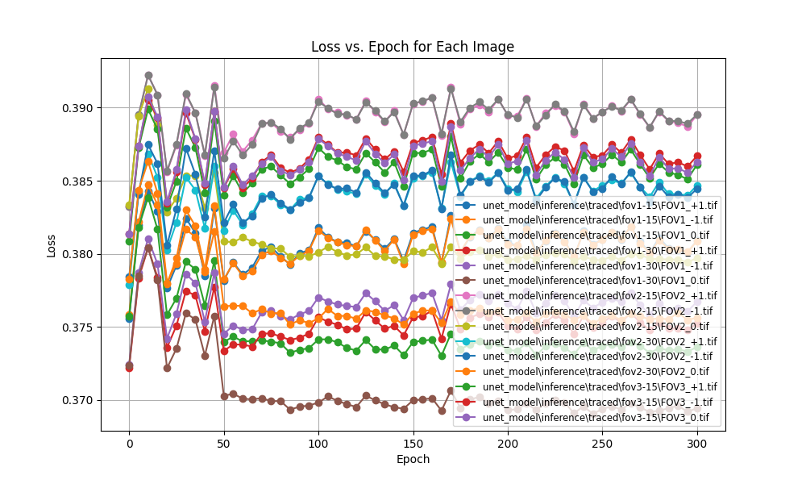
Loss vs. Epoch (multiple images)
Looked just like noise

Slide 5
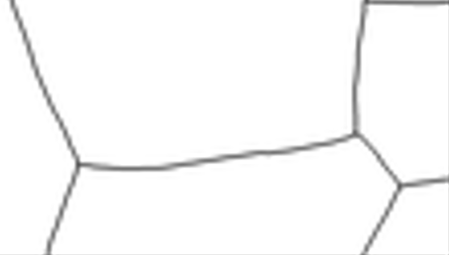
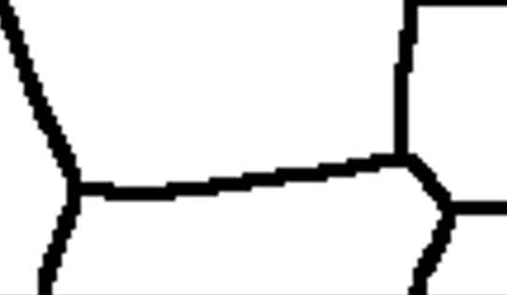
Training Image Issues
GIMP output
Binarized + dilated
GIMP output not binarized
Binarize + dilate to different thicknesses for evaluation

Slide 6
Image/Label Generation from Validation Dataset

Slide 7
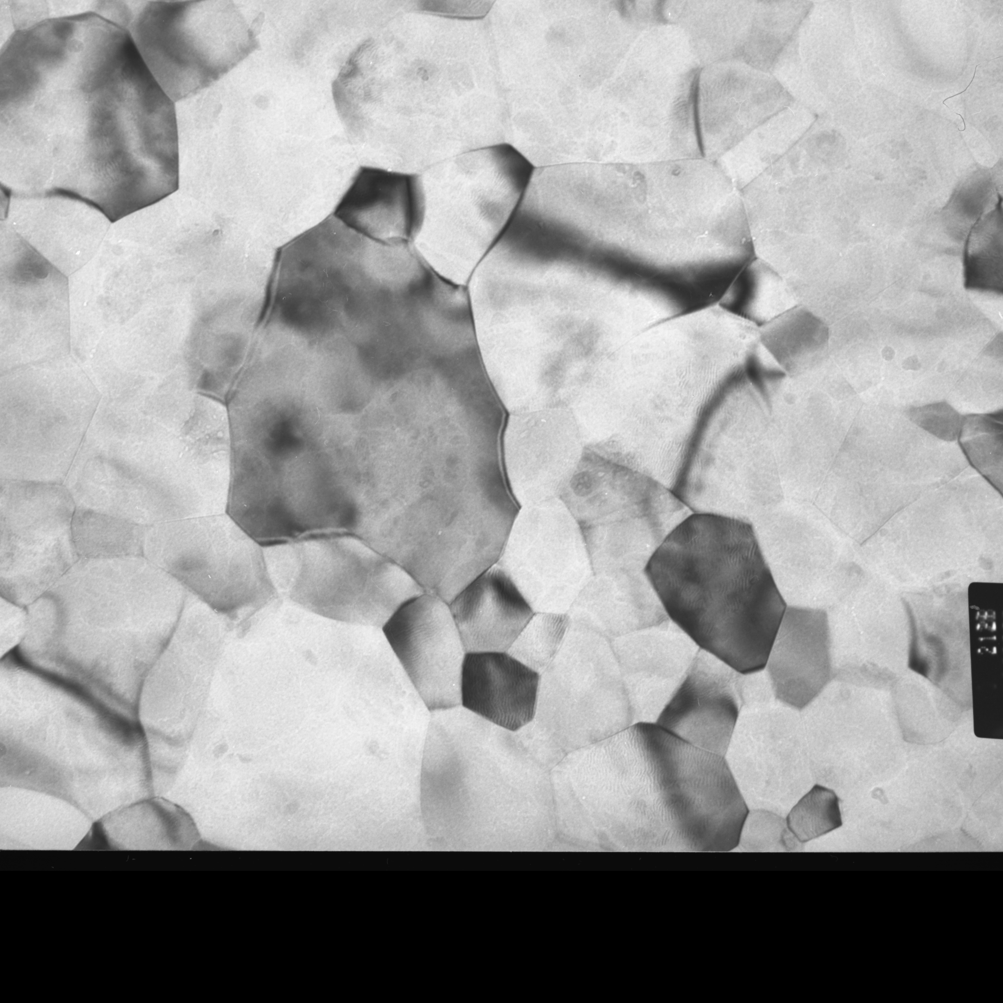
Notes:
An actual image

Slide 8
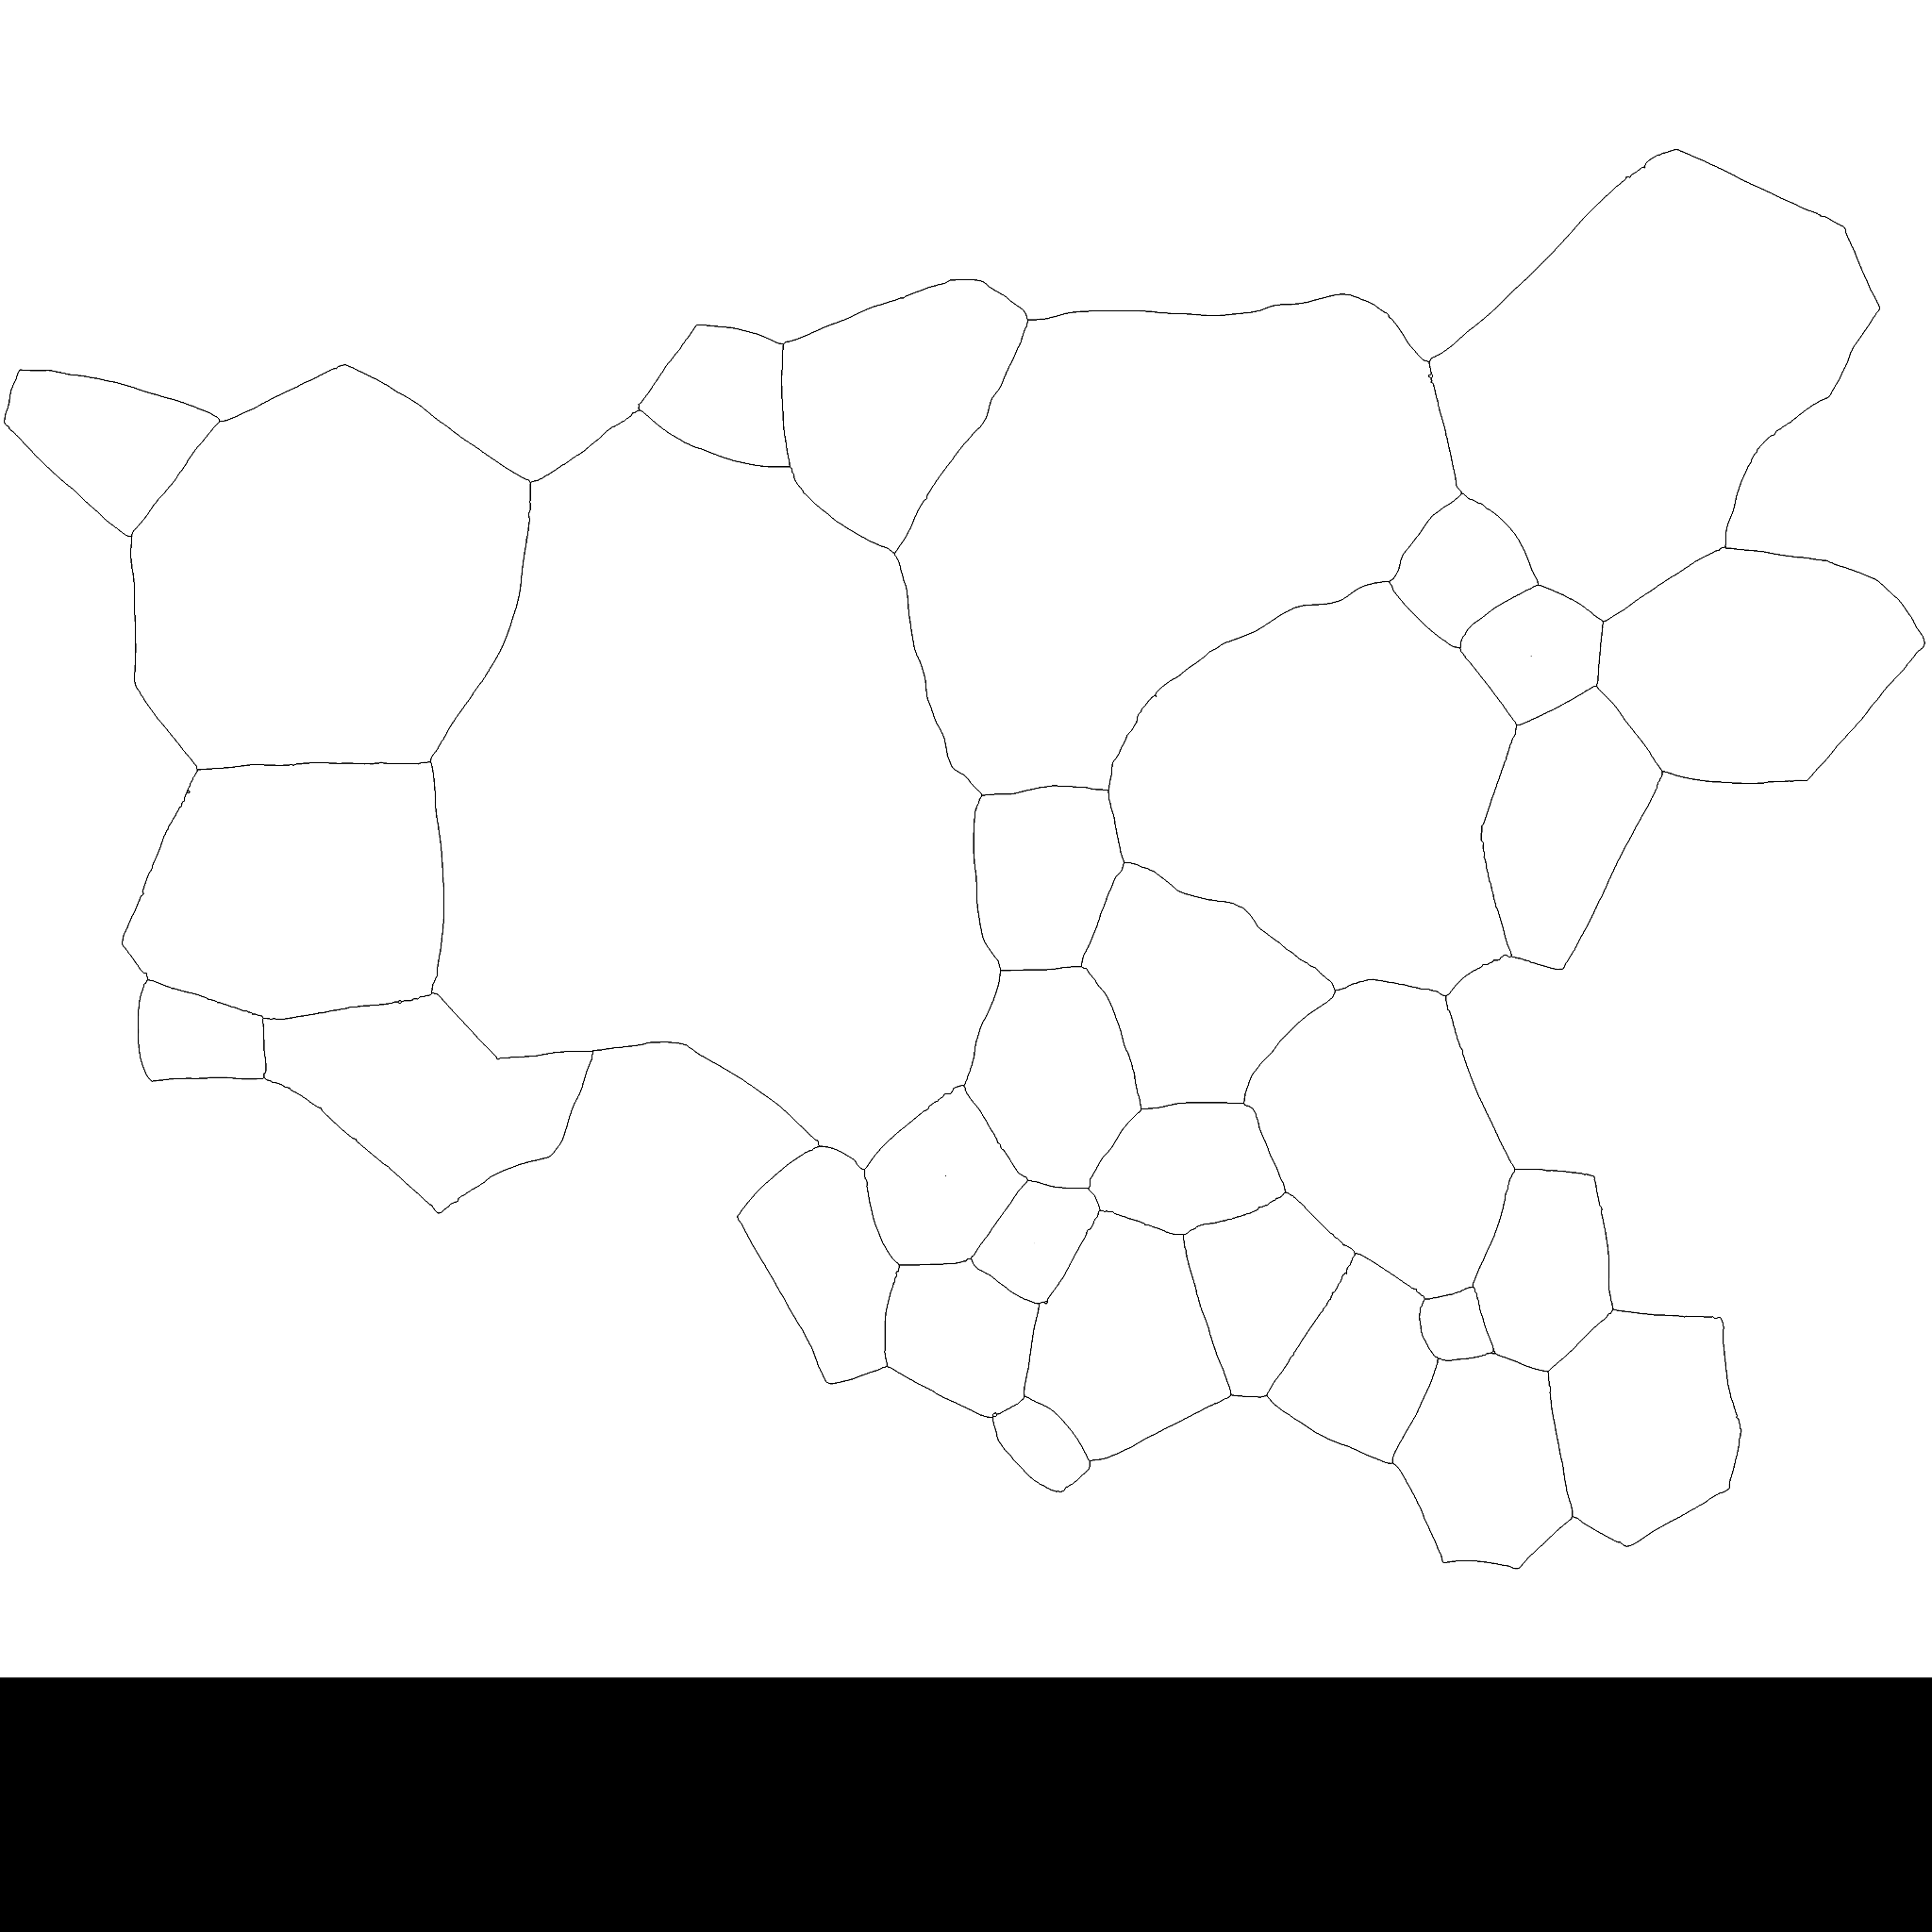
Notes:
The corresponding tracing of that image

Slide 9
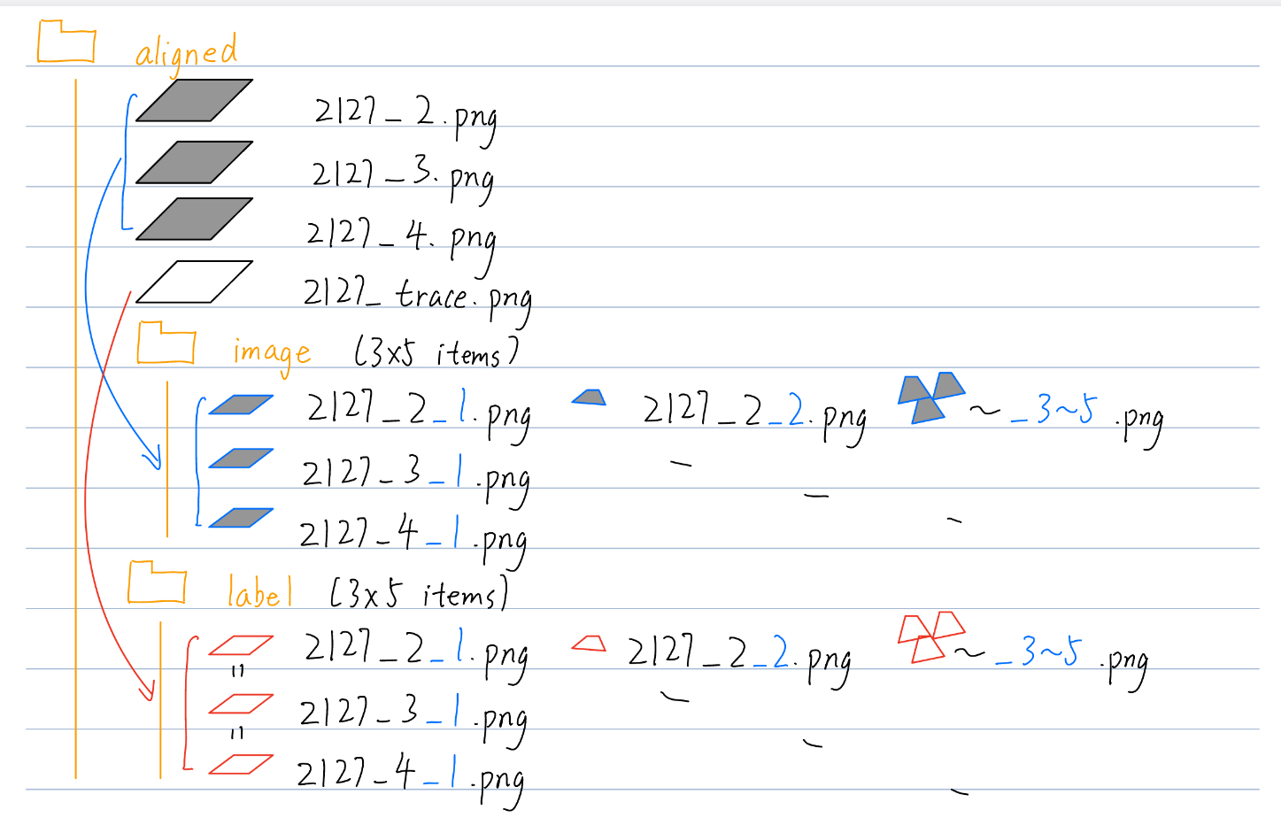
Folder Organization
image folder:
Row: angle
Column: patch
label folder: Corresponding trace.
Each column is the same

Slide 10
Loss Function
Evaluation
Ming Gong
Apr. 8, 2025

Slide 11
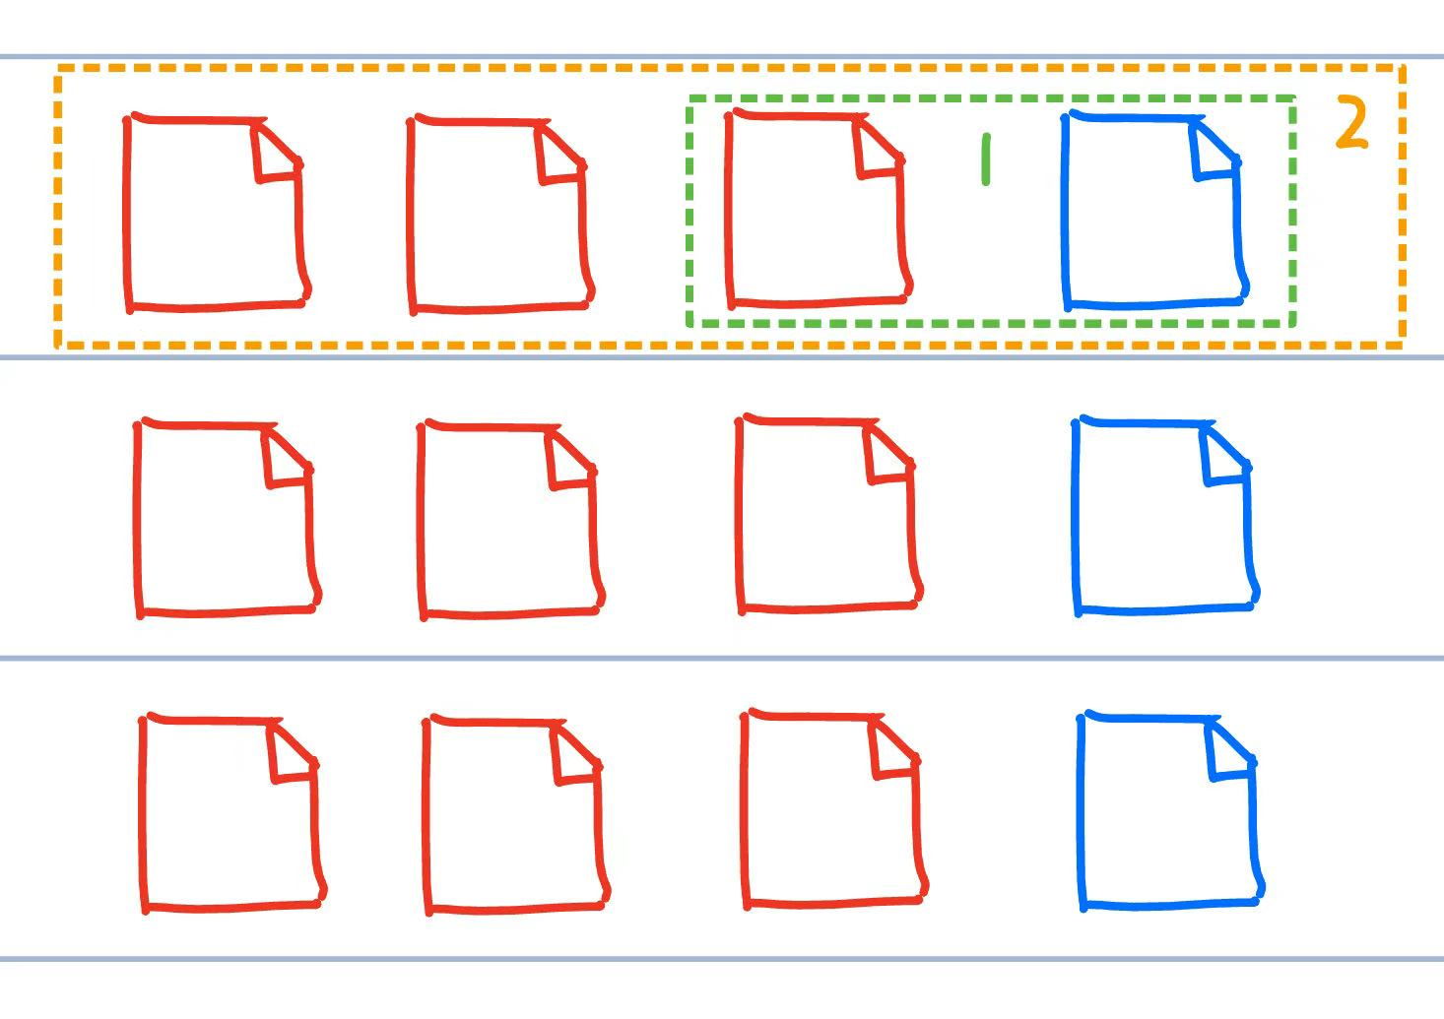
Workflow
Analyze the performance of various models/epochs
Single evaluation on one image with one model
single_eval(image, tracing, model, loss_fn) -> float:
Evaluation of a folder of input, but the same model/tracing
multi_eval(image_paths, tracing, model, loss_fn) -> list[dict]:
Evaluation across folders, with multiple tracings and models
multi_epoch_eval(root_folder, image_pattern, tracing_pattern,
model_dir, epochs: list[int], loss_fn) -> list[dict]:

Slide 12
Preprocessing images
Image
Crop to the same size as tracing (optional)
Output
1024x1024 directly from the model
Tracing (truth)
Resize to the model output
Binarize and invert
Dilate (optional)
Skeletonize (optional)
Convert to tensor
output shape: ([1024, 1024]), range:(0.0000, 1.0000), mean:0.9629
truth shape: ([1024, 1024]), range:(0.0000, 1.0000), mean:0.9100

Slide 13



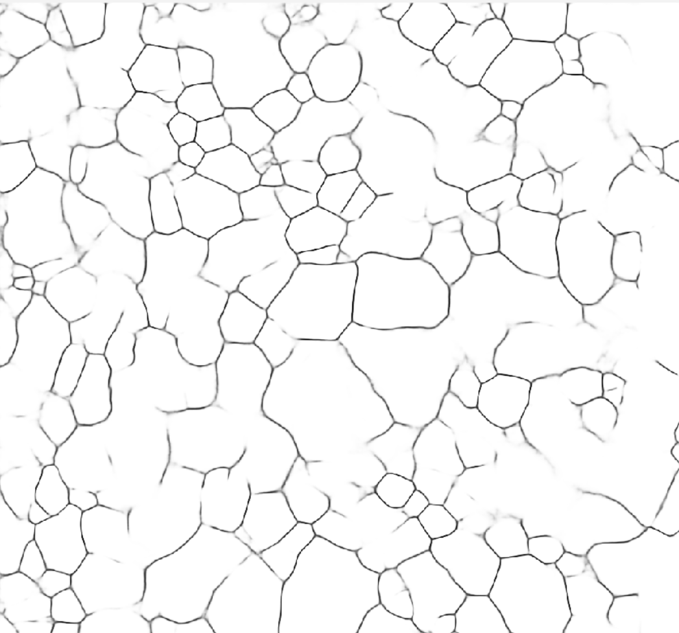
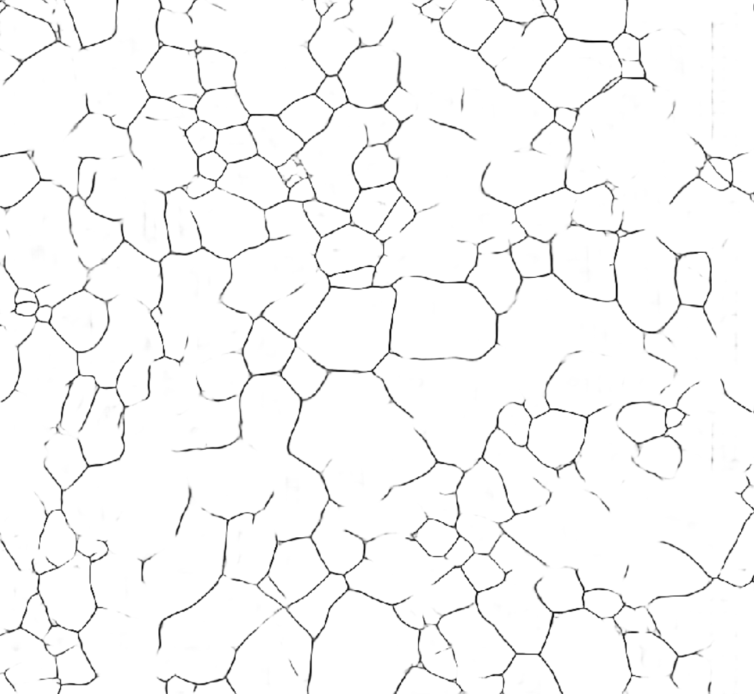
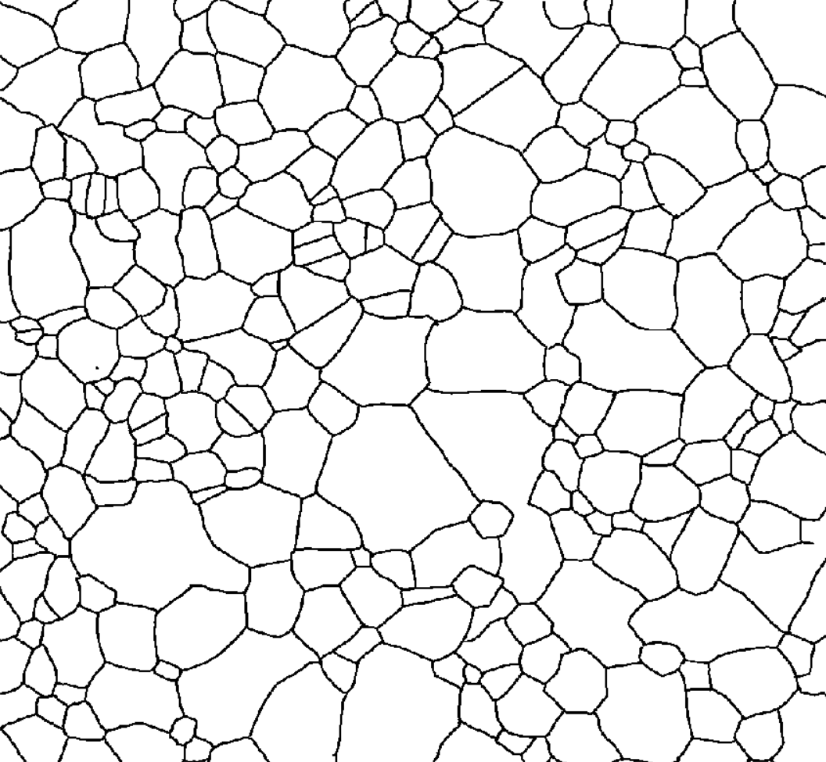
Output vs Epoch (BCE Loss Function)
Epoch = 0
Epoch = 30
Epoch = 60
Epoch = 90
Epoch = 300
Truth

Slide 14
BCE Logit Issue
loss_fn = nn.BCEWithLogitsLoss()
loss = loss_fn(output_data, output_data)
return loss.item()
Very high losses (0.3) and minimal change (0.015)

Slide 15
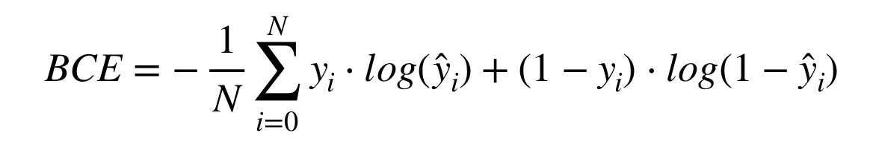
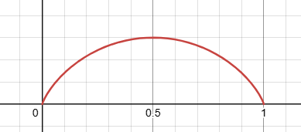
BCELoss
BCE with Logit applies sigmoid to the inputs, so inputs are expected to range from (-inf, inf).
Since our tensors have range [0, 1], the Logit unnecessarily applies Sigmoid to the input again
If some elements is not 0 or 1 (grayscale), BCE will be non-zero, even when comparing the same image
BCE of two identical pixels. The loss is not zero if the pixels are not black (0) or white (1)

Slide 16
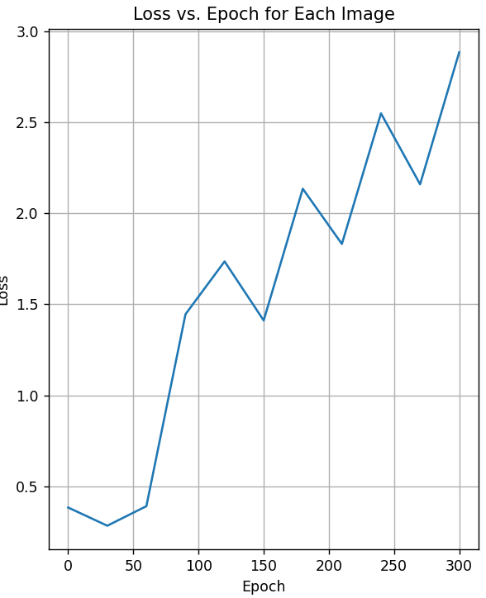
Loss vs. epoch
Result with nn.BCELoss() as loss function
The loss diverges :(

Slide 17
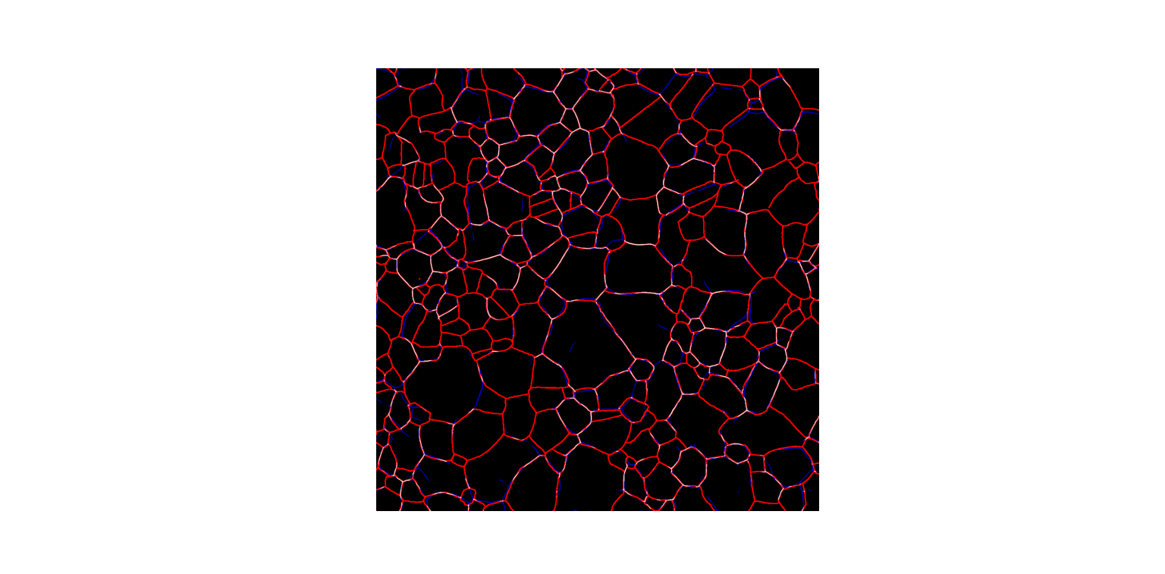
Loss Function
Ming Gong
Apr. 15, 2025

Slide 18
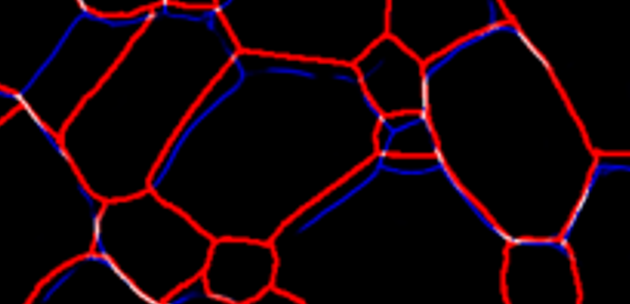
Problem with Bitwise Evaluation
White: correct prediction
Blue: false positive prediction
Red: false negative prediction
Red and blue pixels are penalized by BCE
Issue: slightly misaligned pixels will be double-penalized (red & blue)
Zoomed detail
300 epochs

Slide 19
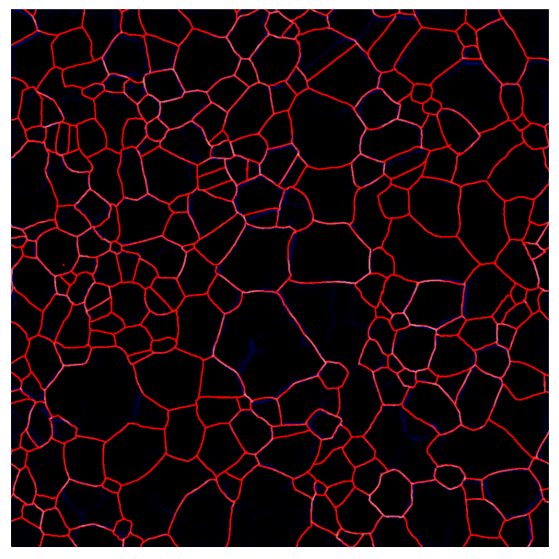
Problem with Bitwise Evaluation
Models that predict blank will get a better BCE loss
50 epochs: loss = 0.31
300 epochs: loss = 2.61

Slide 20
300 Epoch vs. Tracing
300 epochs
Tracing

Slide 21
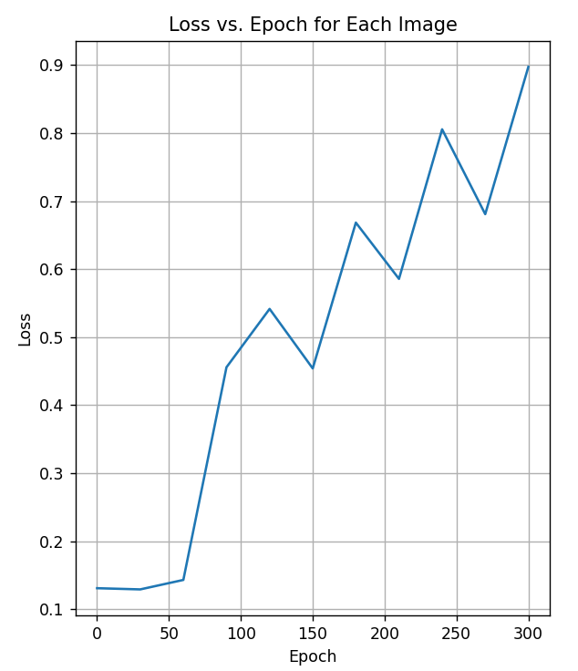
Thinning Applied
The truth tracing is thicker than predicted. Might this be the issue?
Skeletonize truth tracing to 1 px wide before computing the loss
BCE Loss magnitude dropped, but still diverged

Slide 22
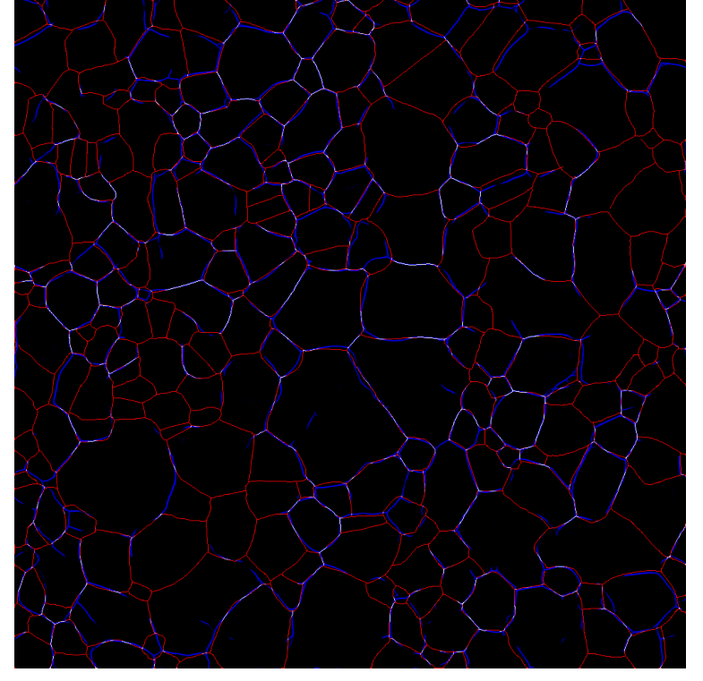
Thinned Tracing
No difference. Misalignment still double-penalized
Thinned tracing
Original tracing

Slide 23
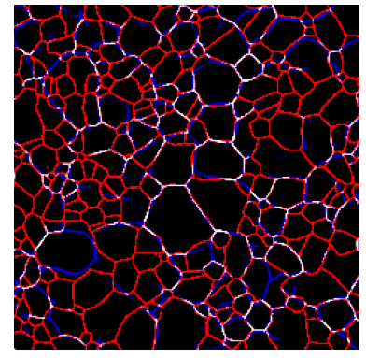
Output Resolution
A lower output resolution can’t solve misalignment
256 x 256
1024 x 1024

Slide 24
Problem with Bitwise Comparison
Red and blue are all counted as errors by BCE
Miss by a small margin will double the error
Simply predicting blank will evaluate better
Solution: dilate the truth tracing, calculate the overlaps

Slide 25
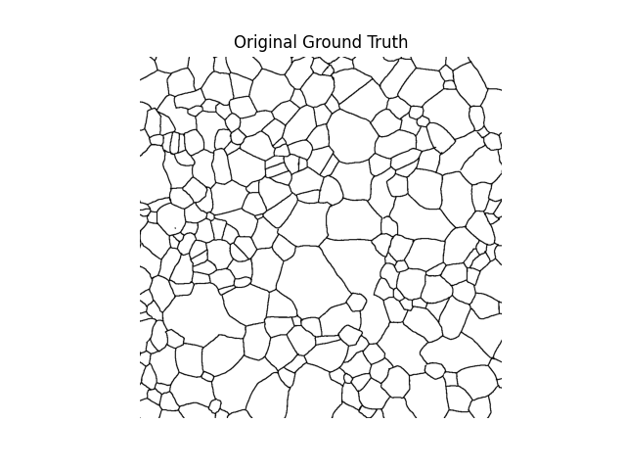
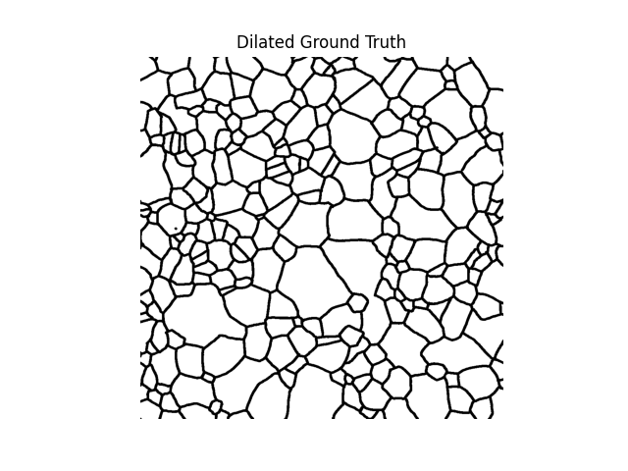
Top-Hat Dilation
Kernel size = 3

Slide 26
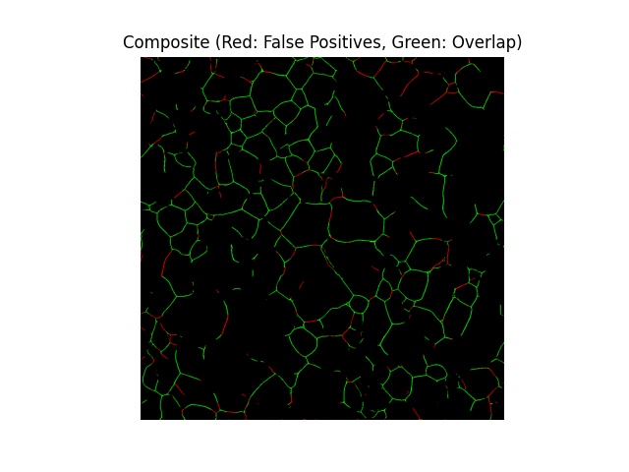
Loss Metric
Binary classification on predicted pixels
Within dilated truth: rewarded (green)
Outside dilated truth: penalized (red)
Loss = red pixel count - green pixel count

Slide 27
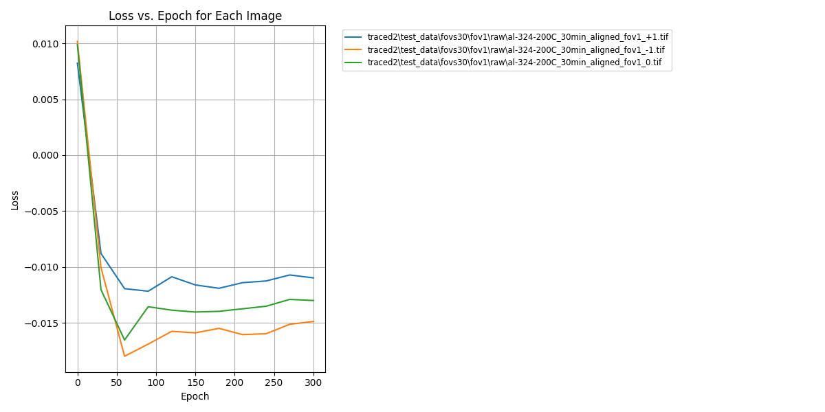
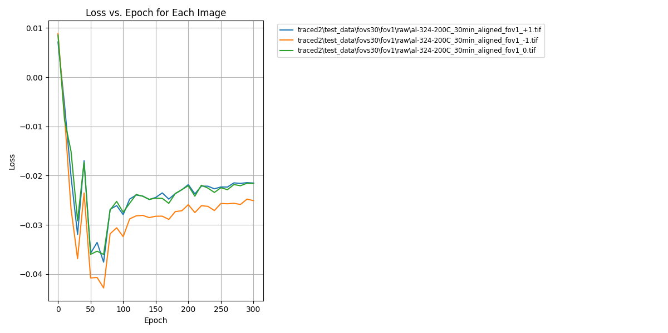
Results for 3 FOVs
Dilation kernel = 3
Dilation kernel = 5

Slide 28
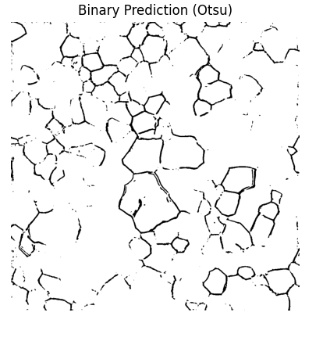
Otsu Thresholding Issue
At intermediate epochs, predictions are gray and blurry
Otsu binaries them to 1 -> good loss near 50 epochs

Slide 29
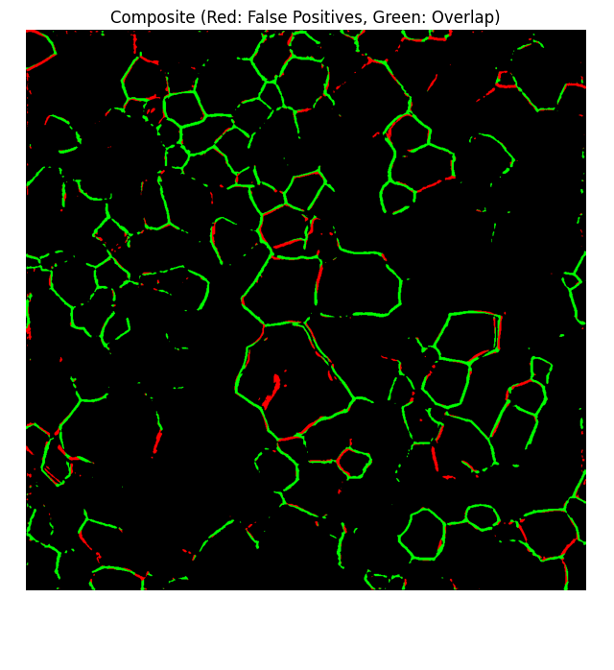
Otsu Thresholding Issue
Lots of green pixels, due to thicker predictions after binarization
but not a lot of segments captured

Slide 30
Next Steps
Dilate with different weights
Better thresholding (penalize uncertainty)
Metric for the entire picture (penalize missing large areas)

Slide 31
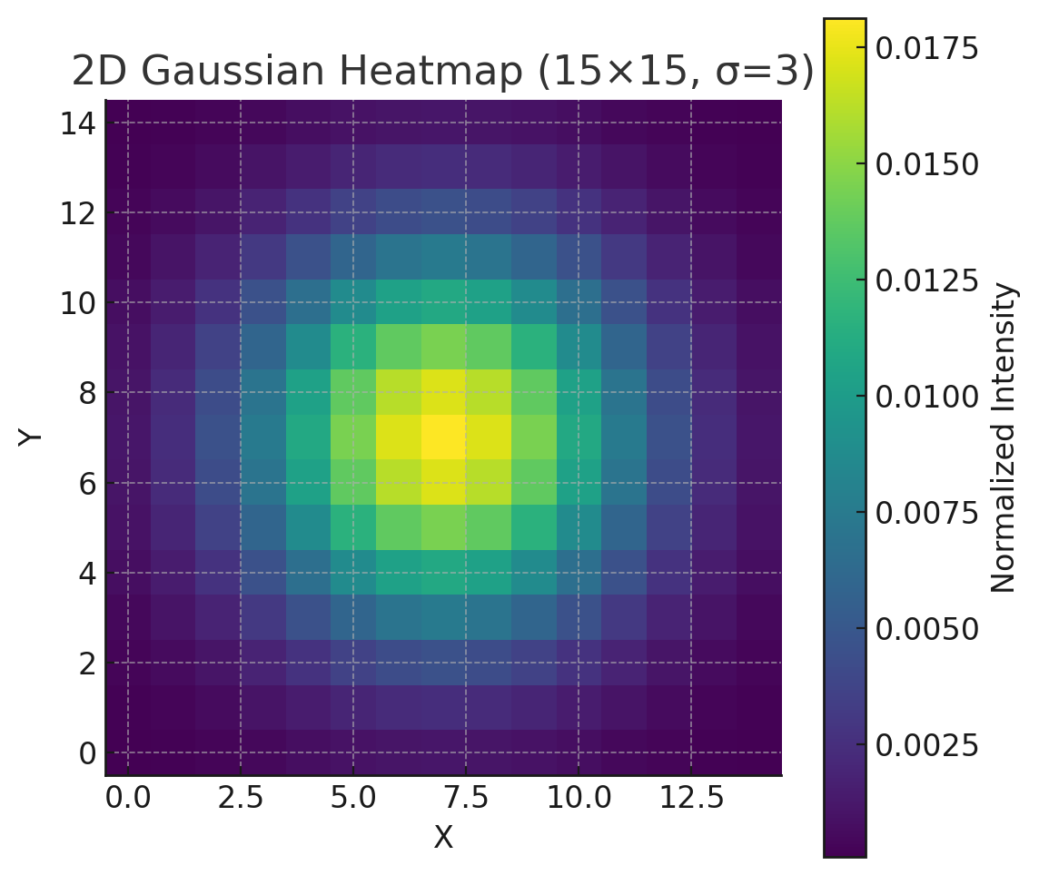
Loss Function
(Gaussian)
Ming Gong
Apr. 22, 2025

Slide 32
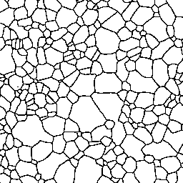
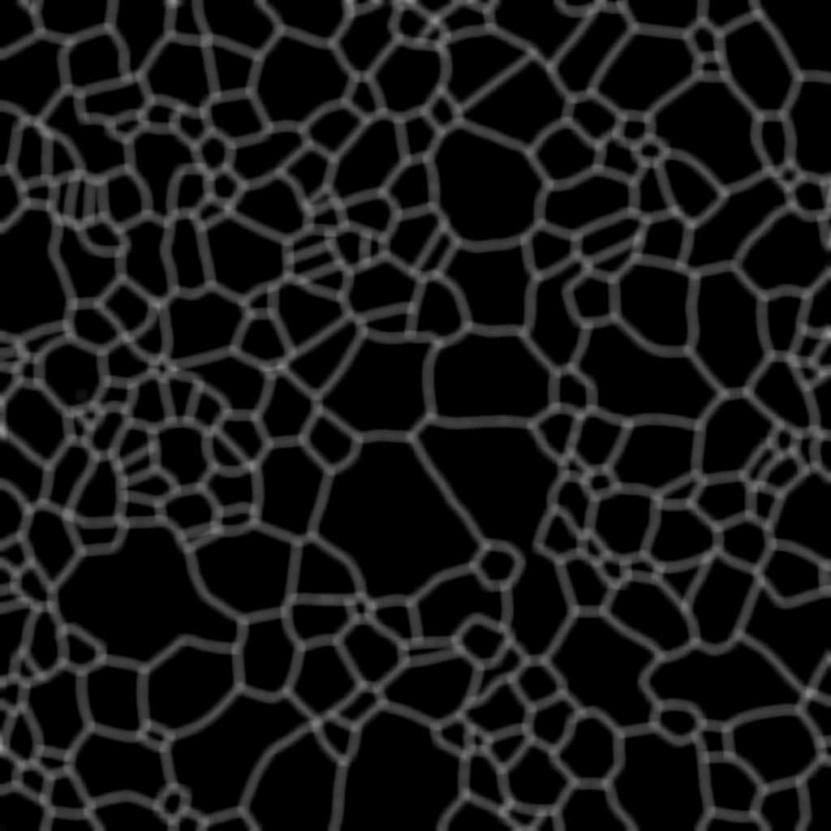
Truth Gaussian Dilation
Original tracing
Inverted & dilated with a Gaussian kernel

Slide 33
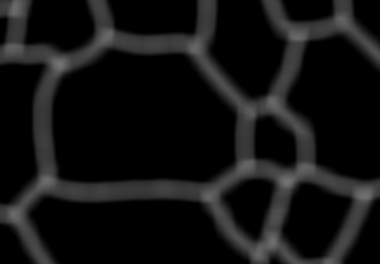
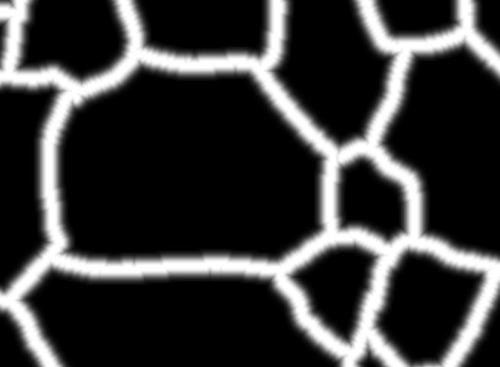
Gaussian Max
Intersections were given more weight under Gaussian kernel
Avoid overcounting intersections
For each pixel, only pick the greatest value from itself or its neighbors
Normalize to [0, 1]
Gaussian dilation
Normalized Gaussian

Slide 34
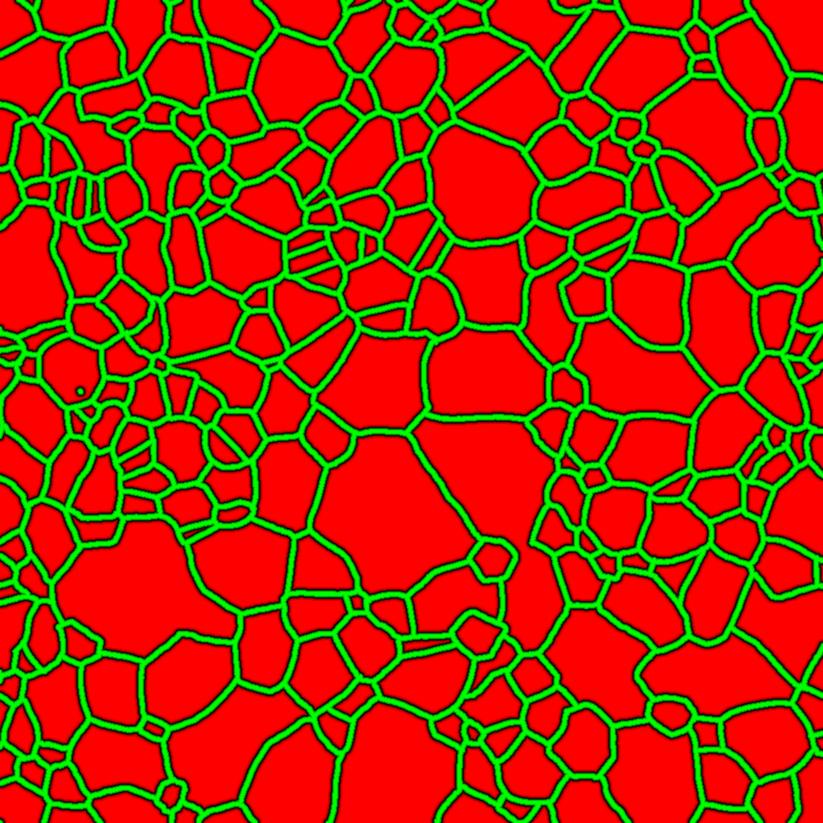
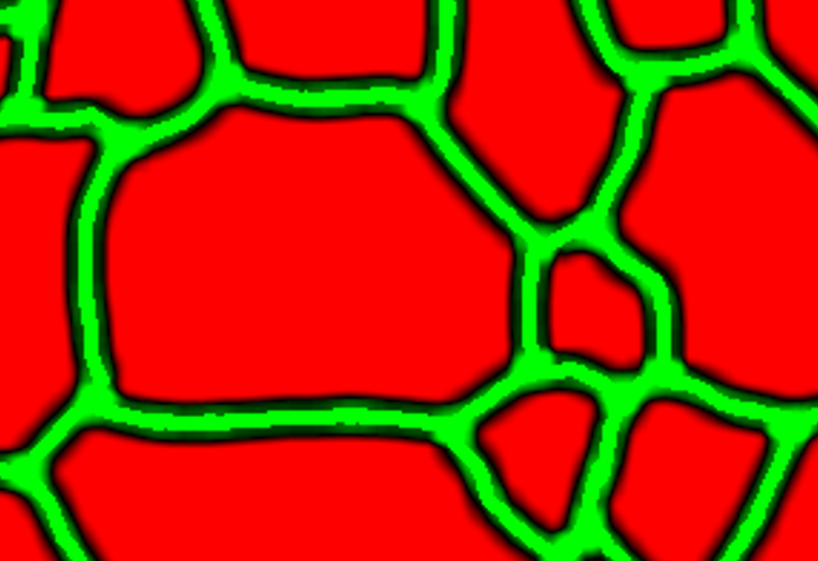
Reward image
Scale to [-1, 1]
Green pixel: loss = -1
Red pixel: loss = +1
Black pixel: smooth transition
Tracing: [0, 1]
Reward mask: [-1, 1]
Zoomed-in detail

Slide 35

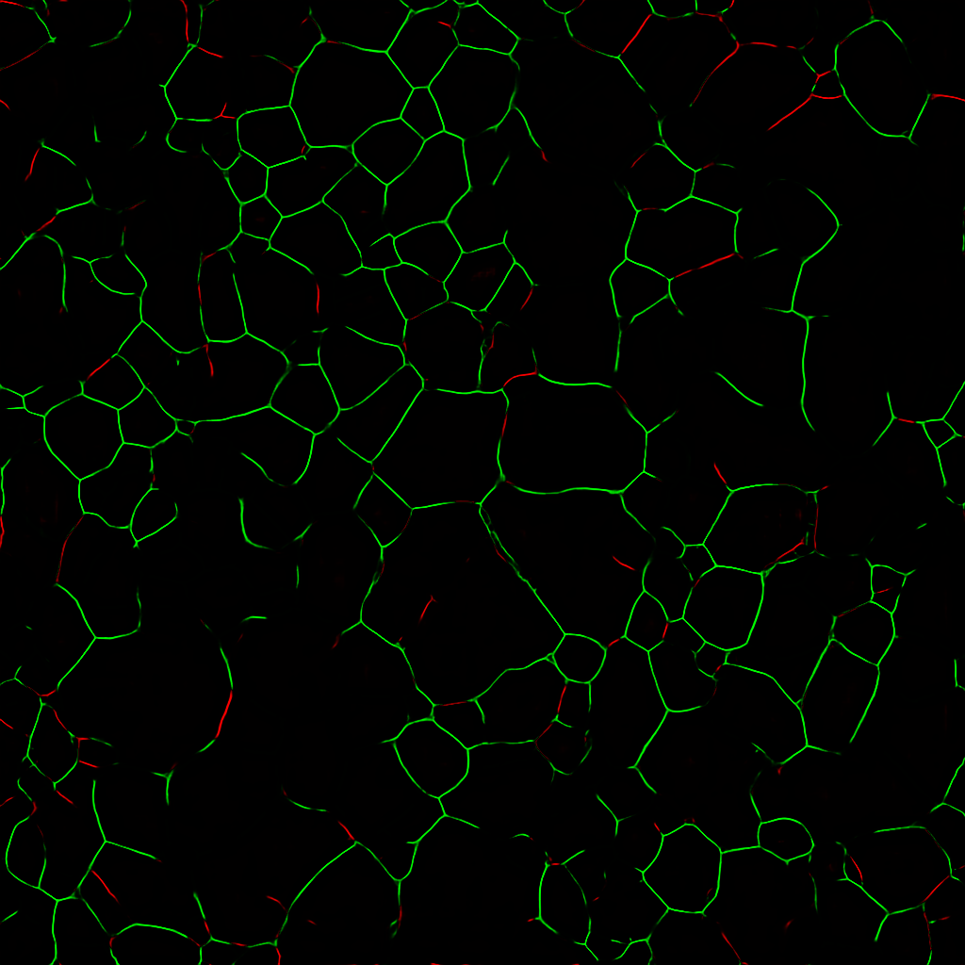
Apply to Model Output
Model output · reward mask = - loss
Green pixels rewarded, red penalized

Slide 36
Binary vs Gaussian Dilation
Epoch=300, loss=-17.9e-3
Top-hat filter Gaussian dilation

Slide 37
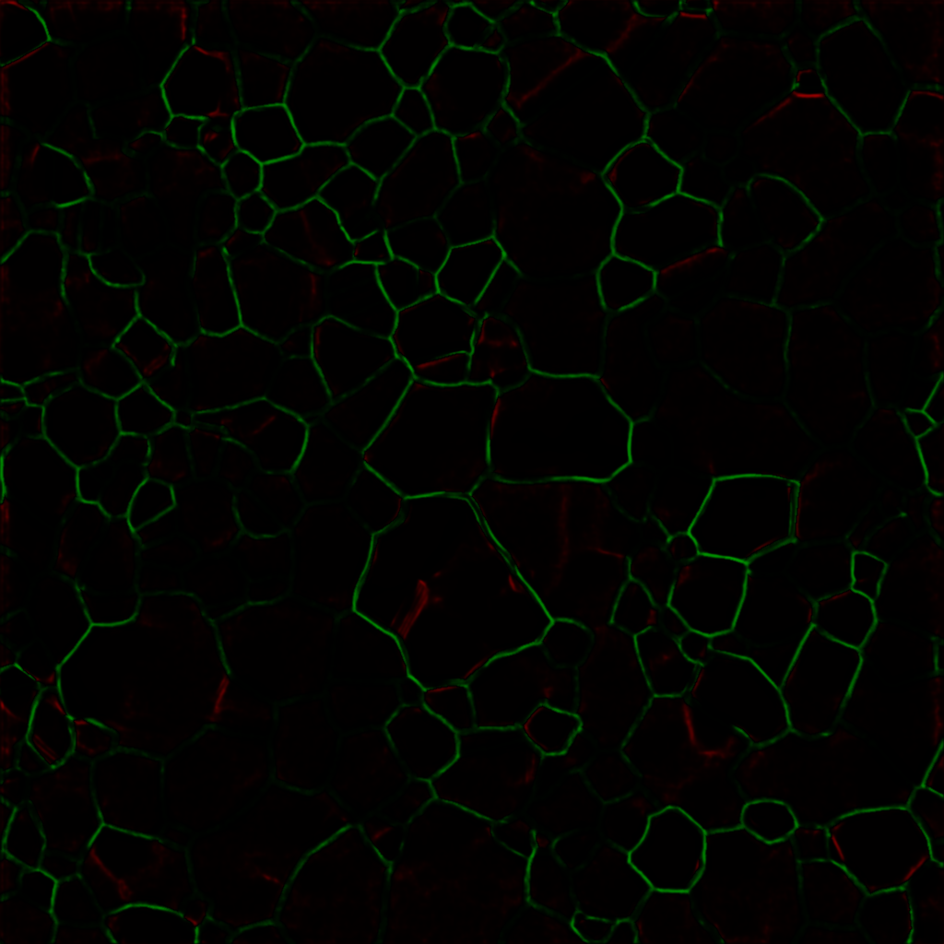
ksize = (15, 15), sigma = 3
Epoch=50, loss=-5.8e-3
Epoch=300, loss=-17.9e-3

Slide 38
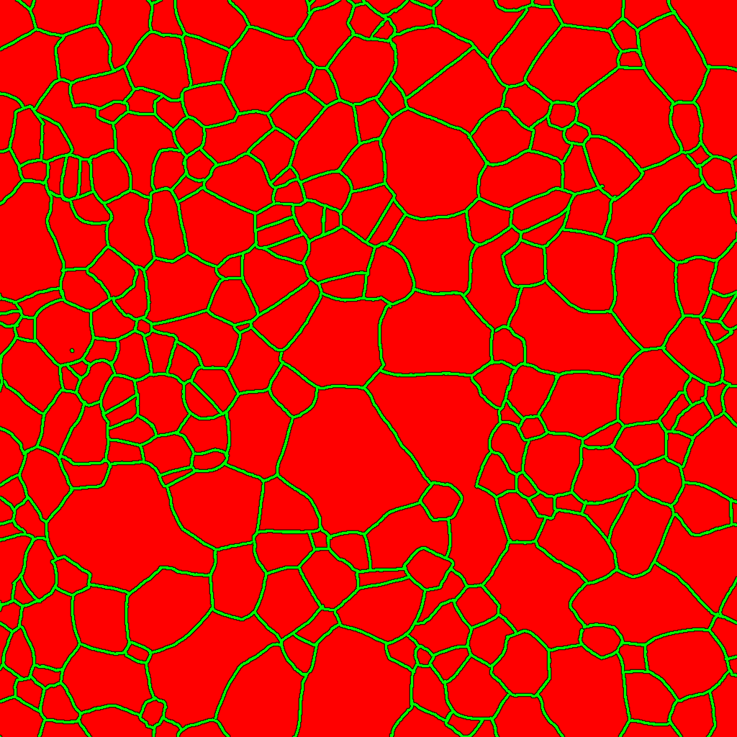
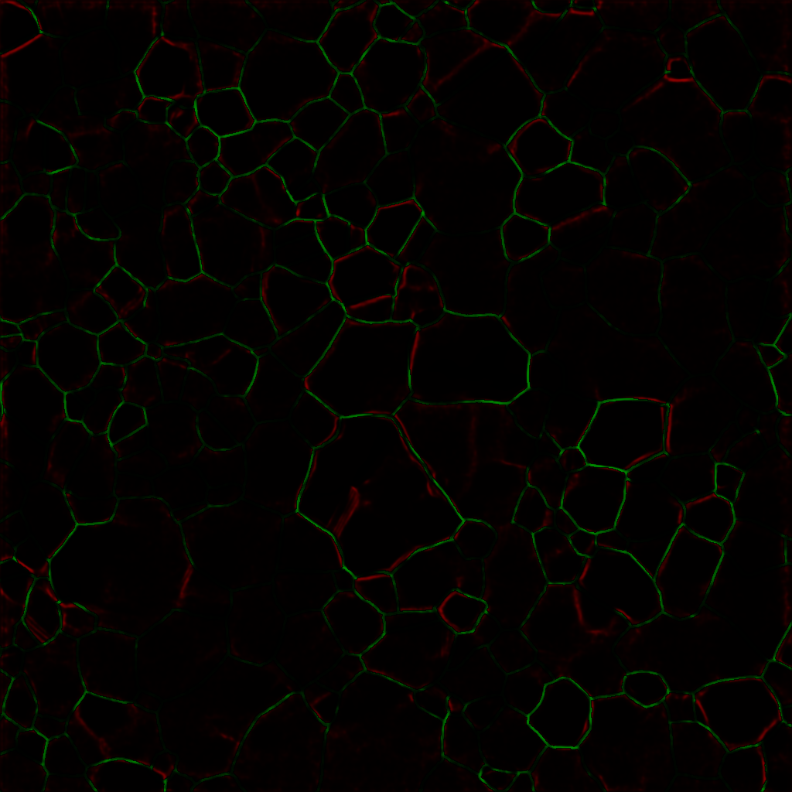
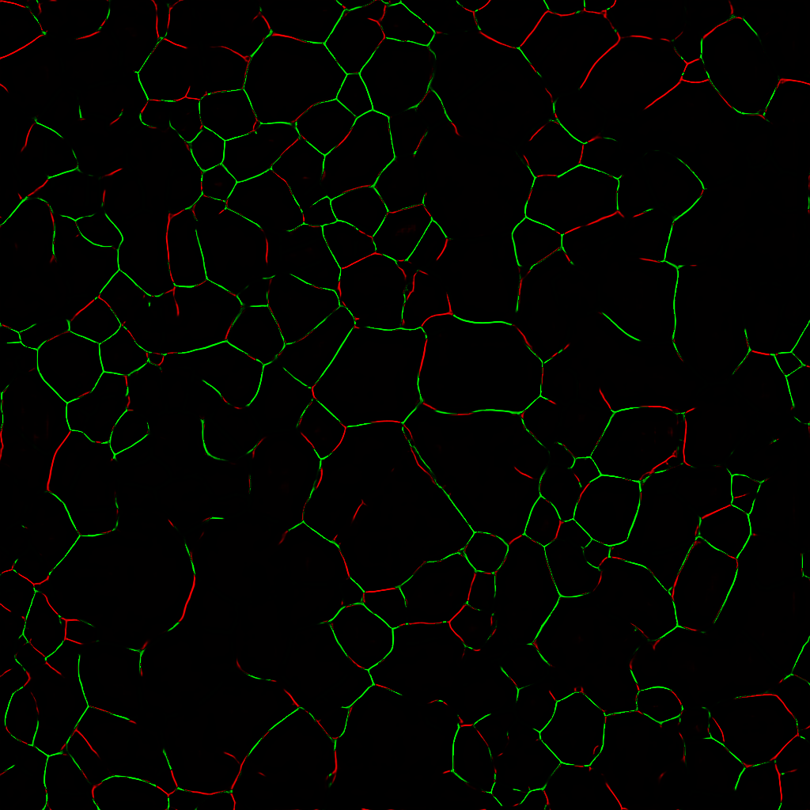
ksize = (15, 15), sigma = 1
Epoch=50, loss=+6.9e-3 Epoch=300, loss=-4.7e-3

Slide 39
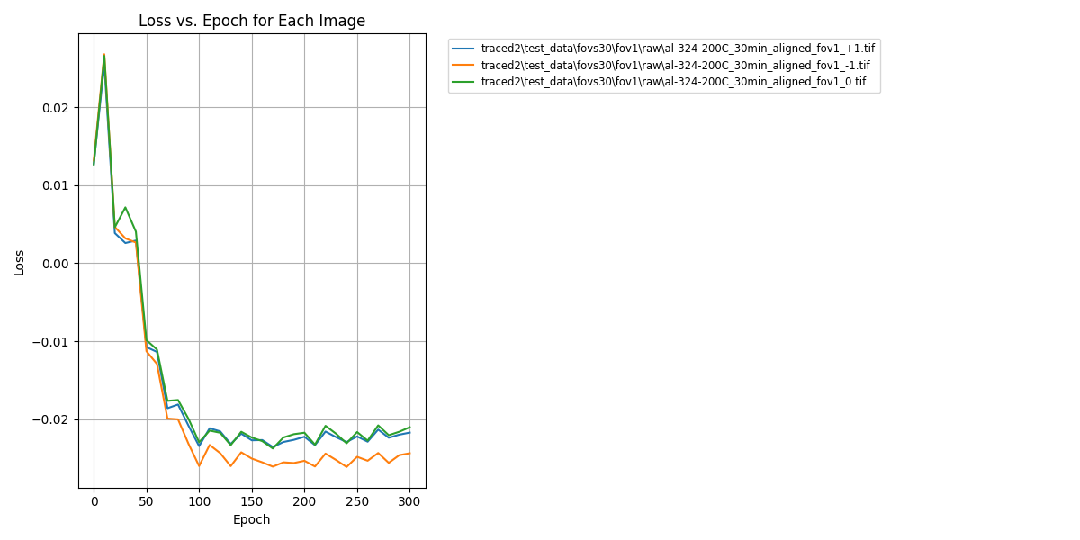
Loss vs. Epoch

